Slide 1
Media Campaigns Based on Social Norms
1. Significant results
2. Examples

Slide 2
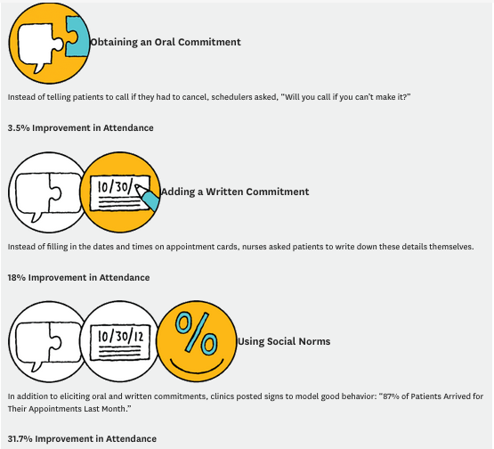
Significant results
Source : http://www.hbr.org

Slide 3
exemples
Source : http://www.rowan.edu

Slide 4
Source : http://imbuedevelopers.com/buildageneration.php

Slide 5
http://imbuedevelopers.com/buildageneration.php

